Slide 1
CreditOne customer spending habits
Data Science process
April 13 2019

Slide 2
Overview
Statement of the goal(s)
The data science process framework and the reasons for proposing it
Descriptions and location of related data sources
An explanation of how we will manage the data for the project
Any known issues with the data and how you plan to address them
A flowchart visualizing the detailed process you will follow, annotated with any potential pitfalls you’ve identified and your proposed solutions to such pitfalls.
Any initial insights you can glean from your quick look at the data.

Slide 3
Statement of goals:
CreditOne risks losing business due to an increase in the number of customers who have defaulted on loans that CreditOne has secured for them, from various partners.
Based on the dataset provided they need us to build a reliable model to forecast beforehand which customers could default on their loans.
Their current process to identify customers that are likely to default on their loans, is inadequate, because they have seen a consistent increase in the number of defaulting customers.
They have provided us with a large dataset consisting of various customer attributes and identified the defaulting and non-defaulting customers.
We will use this dataset for our Data Science process and suggest a model to forecast customers that are likely to default.
This will help CreditOne to remain in business and thrive.

Slide 4
Understanding the problem - Goals of the DS process
Exploratory data analysis
Data Modeling and Analysis
Problem Solving and Decision Support
Data is collected, processed and cleaned using various Data Analytics techniques such as Feature selection, feature elimination, collinearity, outlier detection and reshaping data.
Data set is broken into training and testing sets. Several Data models are tested based on the ground truth on the training and test sets and the best model is chosen based on the resulting Accuracy of the models.
The chosen optimal model is applied to the data set in question and dependant variable values are forecasted, with the highest accuracy possible, for problem solving and making decisions.

Slide 5
Description of the Dataset
The dataset provided by CreditOne consists of the following attributes
Amount of given credit
Gender, Education, Marital status, Age
History of past payments
Amount of bill statement
Amount of previous payment
Did this customer default or not.

Slide 6
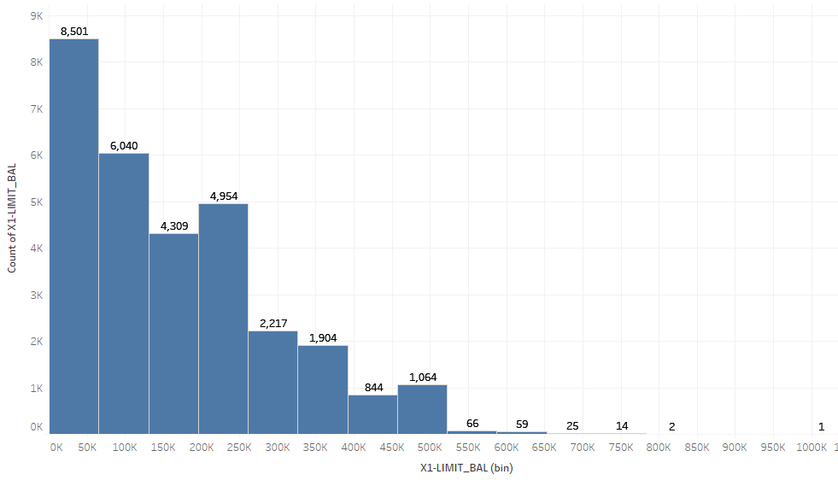
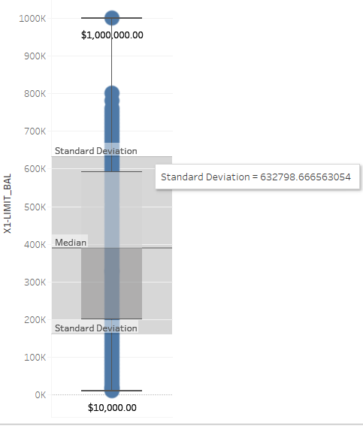
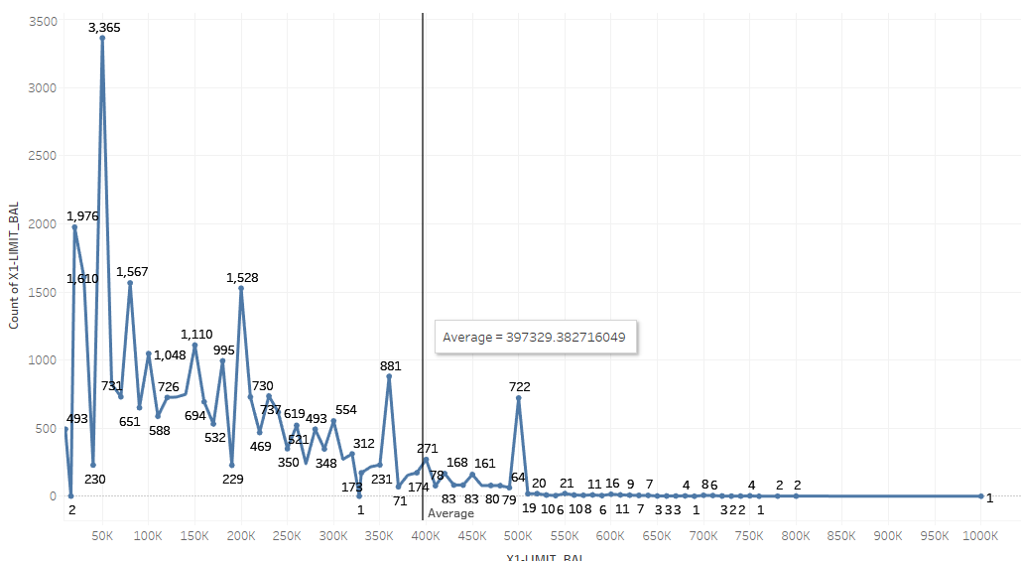
Amount of given credit
The average credit is about $397K and majority of the people in the dataset have a credit limit below average.

Slide 7
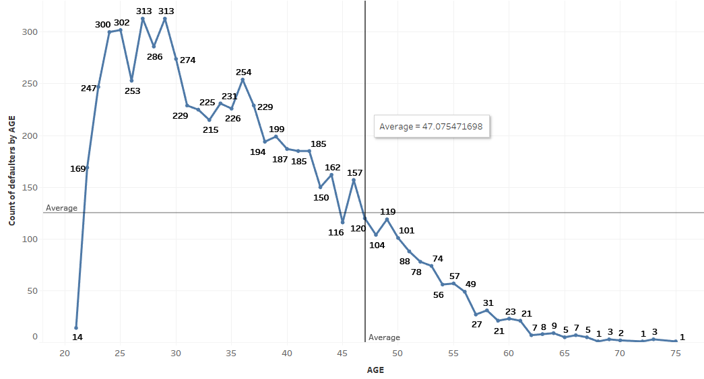
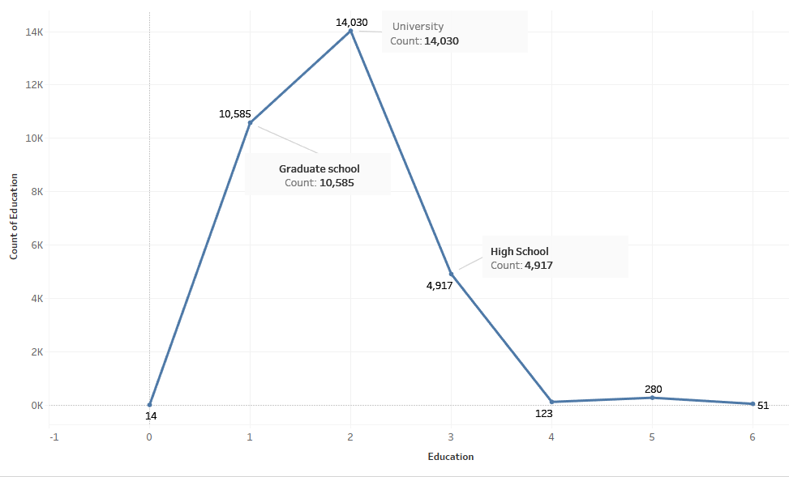
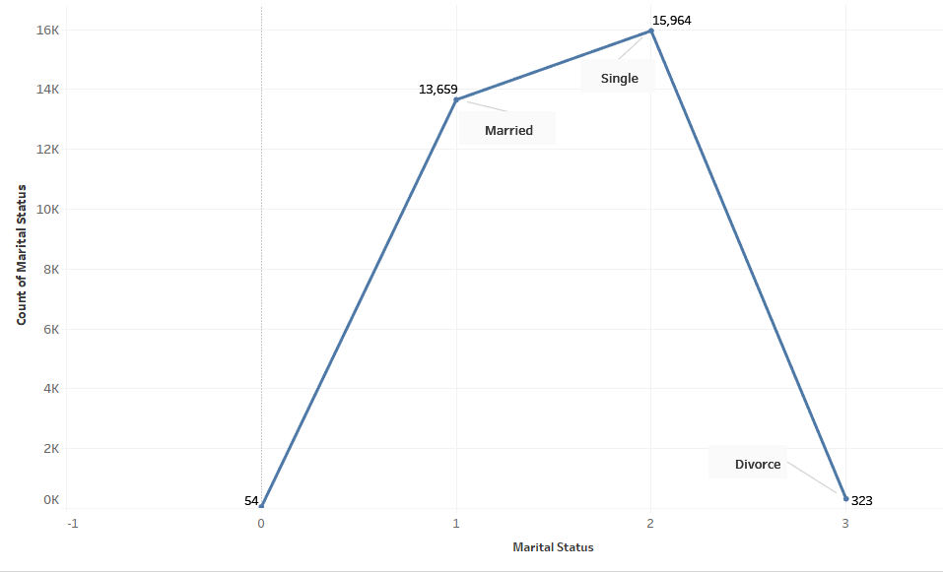
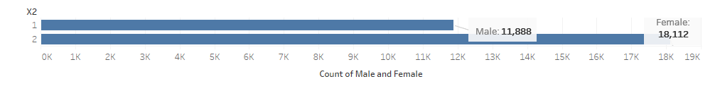
Gender, Education, Age, Marital status
More Females in the dataset than Male.
More University and graduate school educated that any other.
More Married and Single customers than any other status.
More customers under the age of 47 defaulting than over 47.

Slide 8
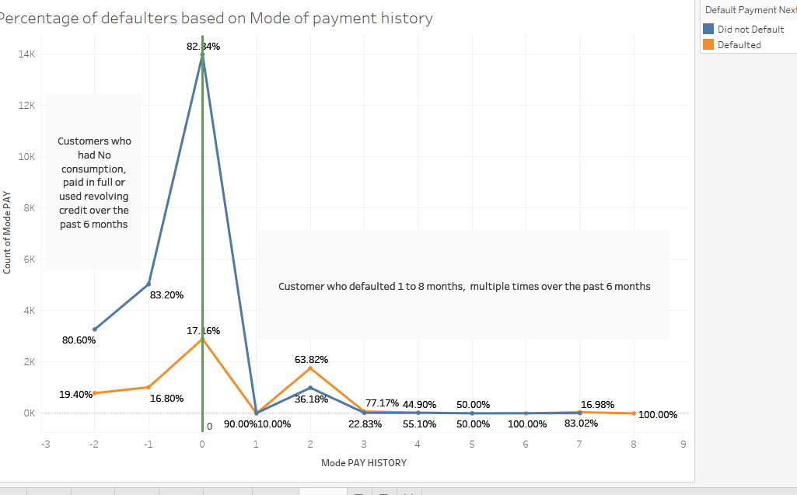
History of past payments
Past payment history shows more customers that defaulted multiple times over a period of 6 months are more likely to default in the next month as well.
About 17% of customers who have not frequently defaulted in the past 6 months are likely to default in the next month.
About 70% of customer who defaulted multiple times in the past 6 months are likely to default in the next month.

Slide 9
Data Science process - Based on Zumel and Mount framework framework
Goal
Identify customers likely to default.
Collect and manage data Customers 6 month payment history data has been made available for analysis.
EDA to evaluate data distribution and quality, make assumptions and clean the dataset.
Build the model
Identify techniques to build the model for customer classification
Evaluate and Critique the model(s)
To find accuracy of the model to classify customers correctly based on historical data
Present results and document
The confidence of the model to classify customer defaulting based on various attributes
Model Maintenance
Identify attributes that are correlated to the defaulting classification. Any change in these attributes will potentially need model revision

Slide 10
Initial Insights
Most defaulting customers had a history of several months of payment delay or using revolving credit in the last 6 months.
Most of the defaulting customers had a credit of $200,000 or less. The highest number of defaulting customers have a credit limit of $50,000 or less.
About 22% of customers default irrespective of their attributes.
The maximum defaulting customers are between the ages of 22 and 35.
Male and Female customers with a credit limit of $50K or less were equally defaulting, however more females with credit limit between $50K -$200K were likely to default.
A larger percentage of divorcees are likely to default as compared to overall defaulting percentages in married and single customers.
There are outliers in the data that will need to be cleaned out.

